Slide 1
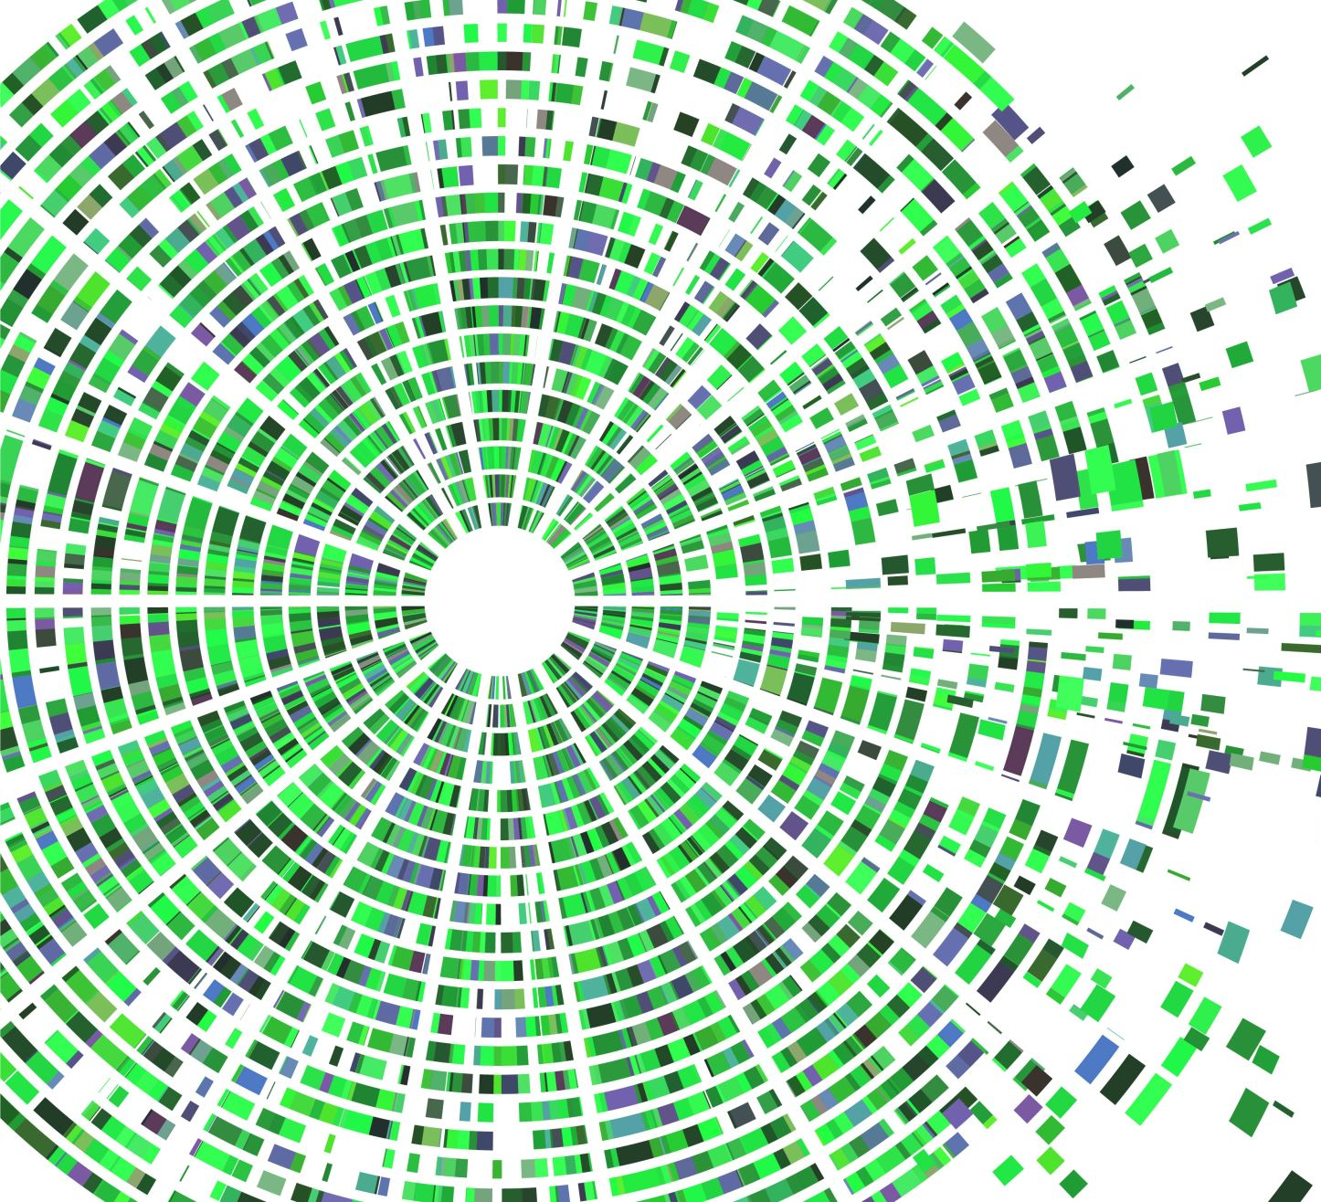
Smart head-mounted LED lights
Nicolas Fouque , WANG Zhe,HE Puyuan

Slide 2
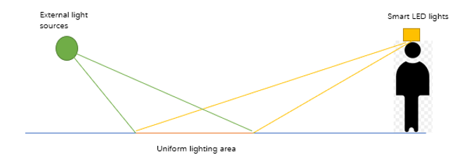
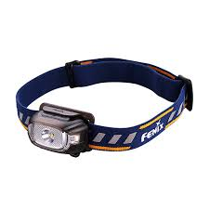
1. Project description
3x3 LED array
& 3x3 photodiode array
Achieve uniform illumination of the target plane by adjusting the LED light array, even if there are random effects from external light sources.

Slide 3
2. System overview
Height,angle
Automatic measurement
By photodiodes
Our system
The distribution of luminance of the target surface
Modified by the LED array
By smart phone
and bluetooth
Expected luminance of the target surface

Slide 4
3. LED lighting module
Results of simulation:
By using Matlab we can know the area that can be illuminated on the target surface
the regional distribution of light intensity on the ground when $θ=30°$ and h=0.3m,1m and 1.7m(from left to right)
the regional distribution of light intensity on the ground when h=0.3m and $θ=30°,45°,60°$(from left to right)

Slide 5
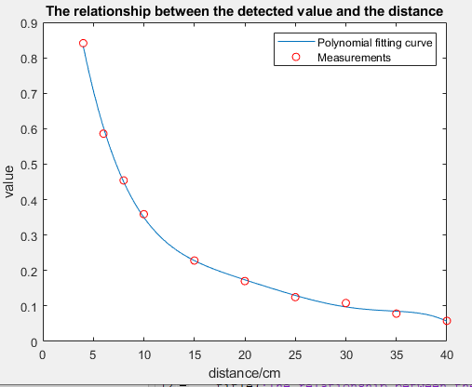
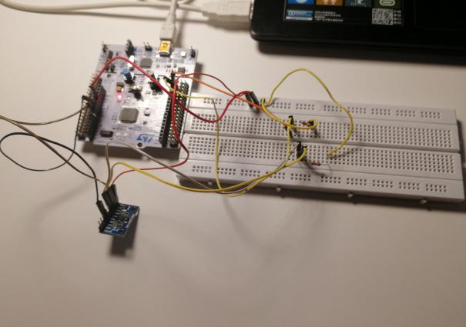
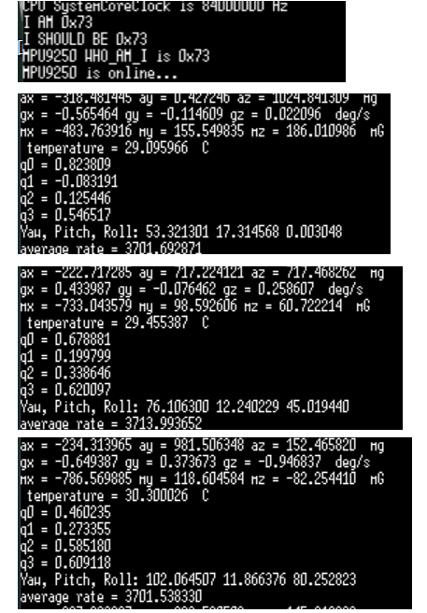
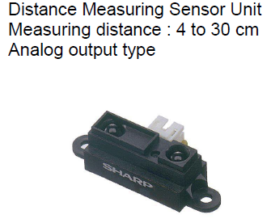
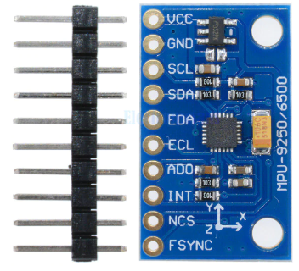
4.Automatic distance and angle measurement module
Sharp GP2Y0A41SK0F
MPU9250
3-axis gyroscope,
3-axis accelerometer,
3-axis magnetometer
We can use it to measure the angle of inclination

Slide 6
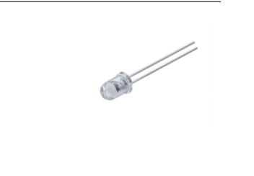
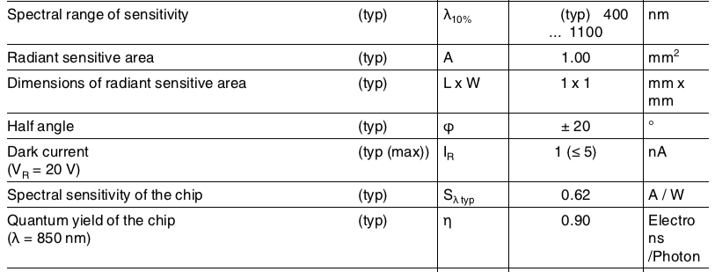
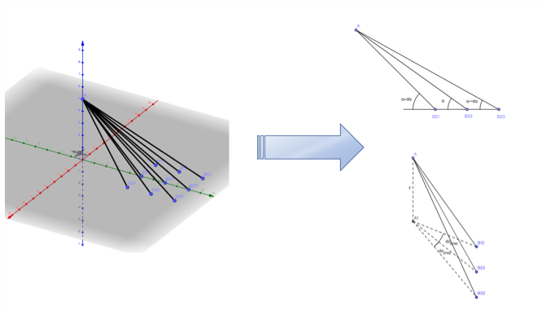
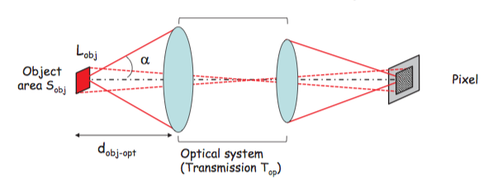
5. Detection system
Photodiode : SFH230
Physical model: 3*3matrix like LED and Flux collet system

Slide 7
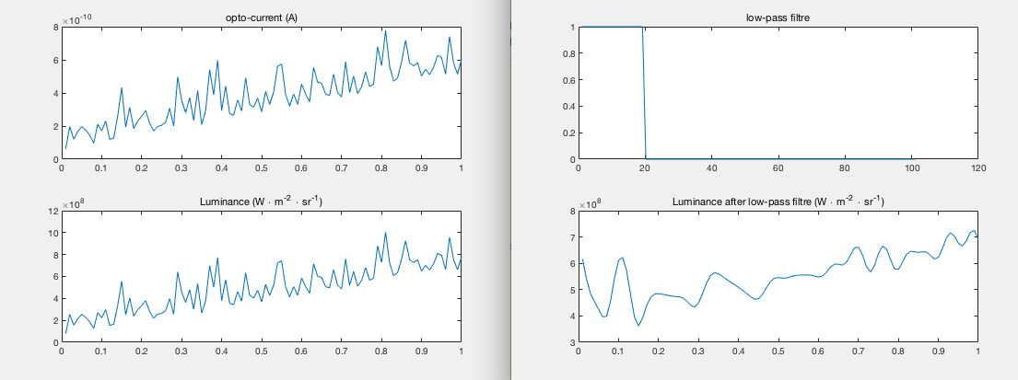
5. Detection system
Trying to reduce the high frequency noise
Using a pow-pass filter to process the data
Final result : the average of the data after the filter ( the 9 photodiodes )

Slide 8
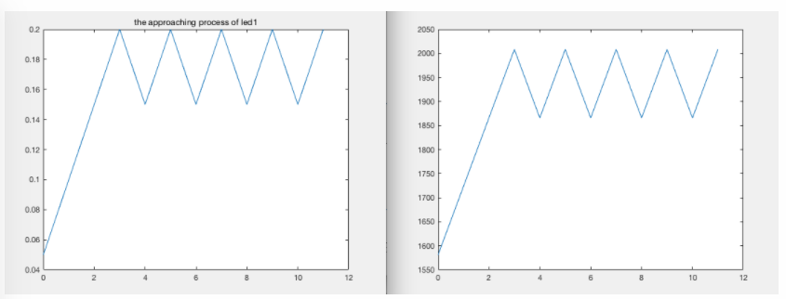
6. Feedback correction module
Adjust the Luminance of LED according to the difference between the target value and measurement value
We have the final result of the nine targets place (every led is in charge of one place )

Slide 9
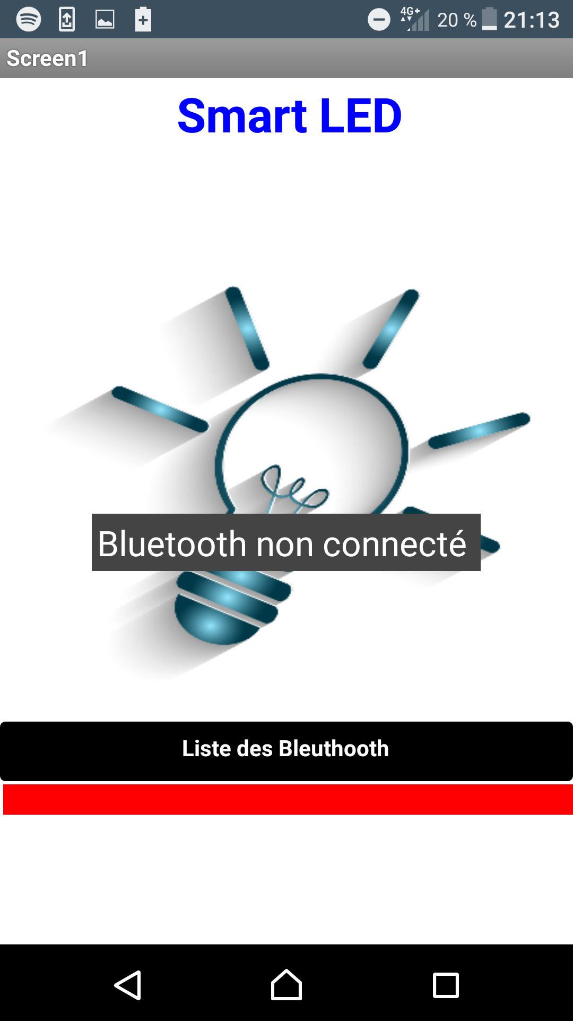
7. Interface Utilisateur

Slide 10
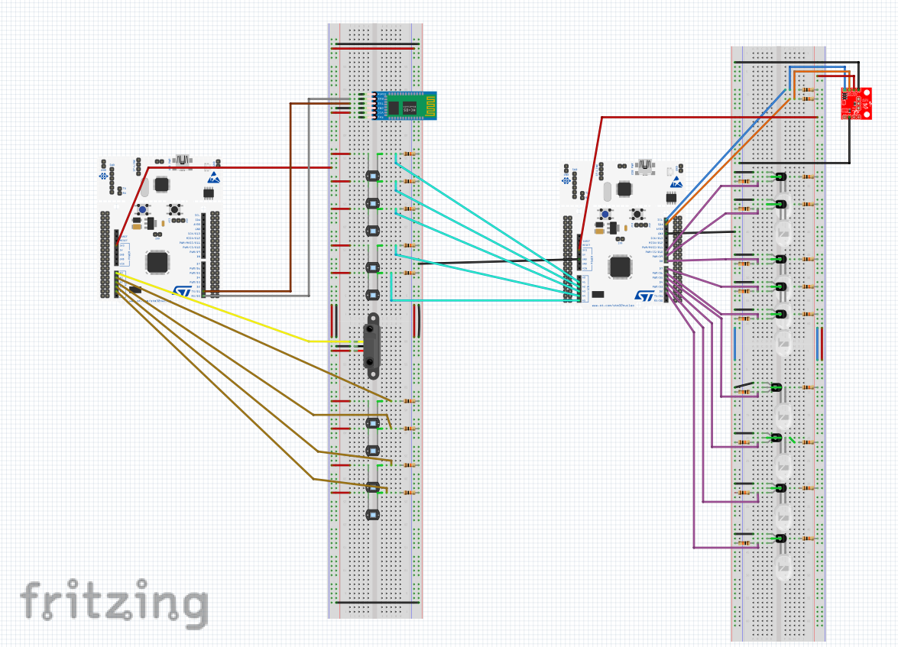
8. Design and Improvement
Compact the device and try to use only one Nucleo
Translate the code in C++ in order to don’t use MATLAB because it’s require a computer
Check the power of this system
Test with other matrice component
Improuve the performance with a Optic design study and lense

