Slide 1
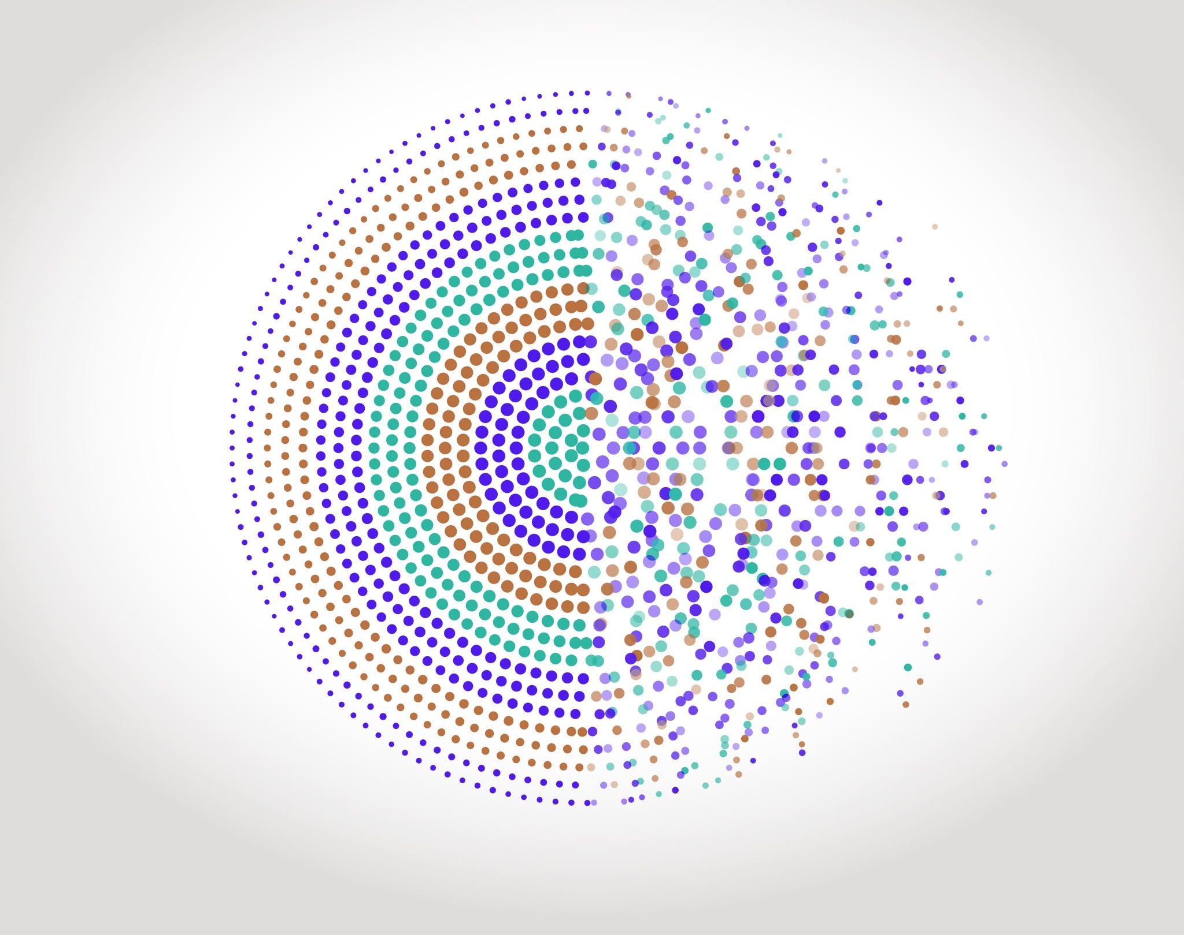
Image processing
Institut d’Optique – Engineers Training
Semester 6 – Digital Interface
Julien VILLEMEJANE

Slide 2
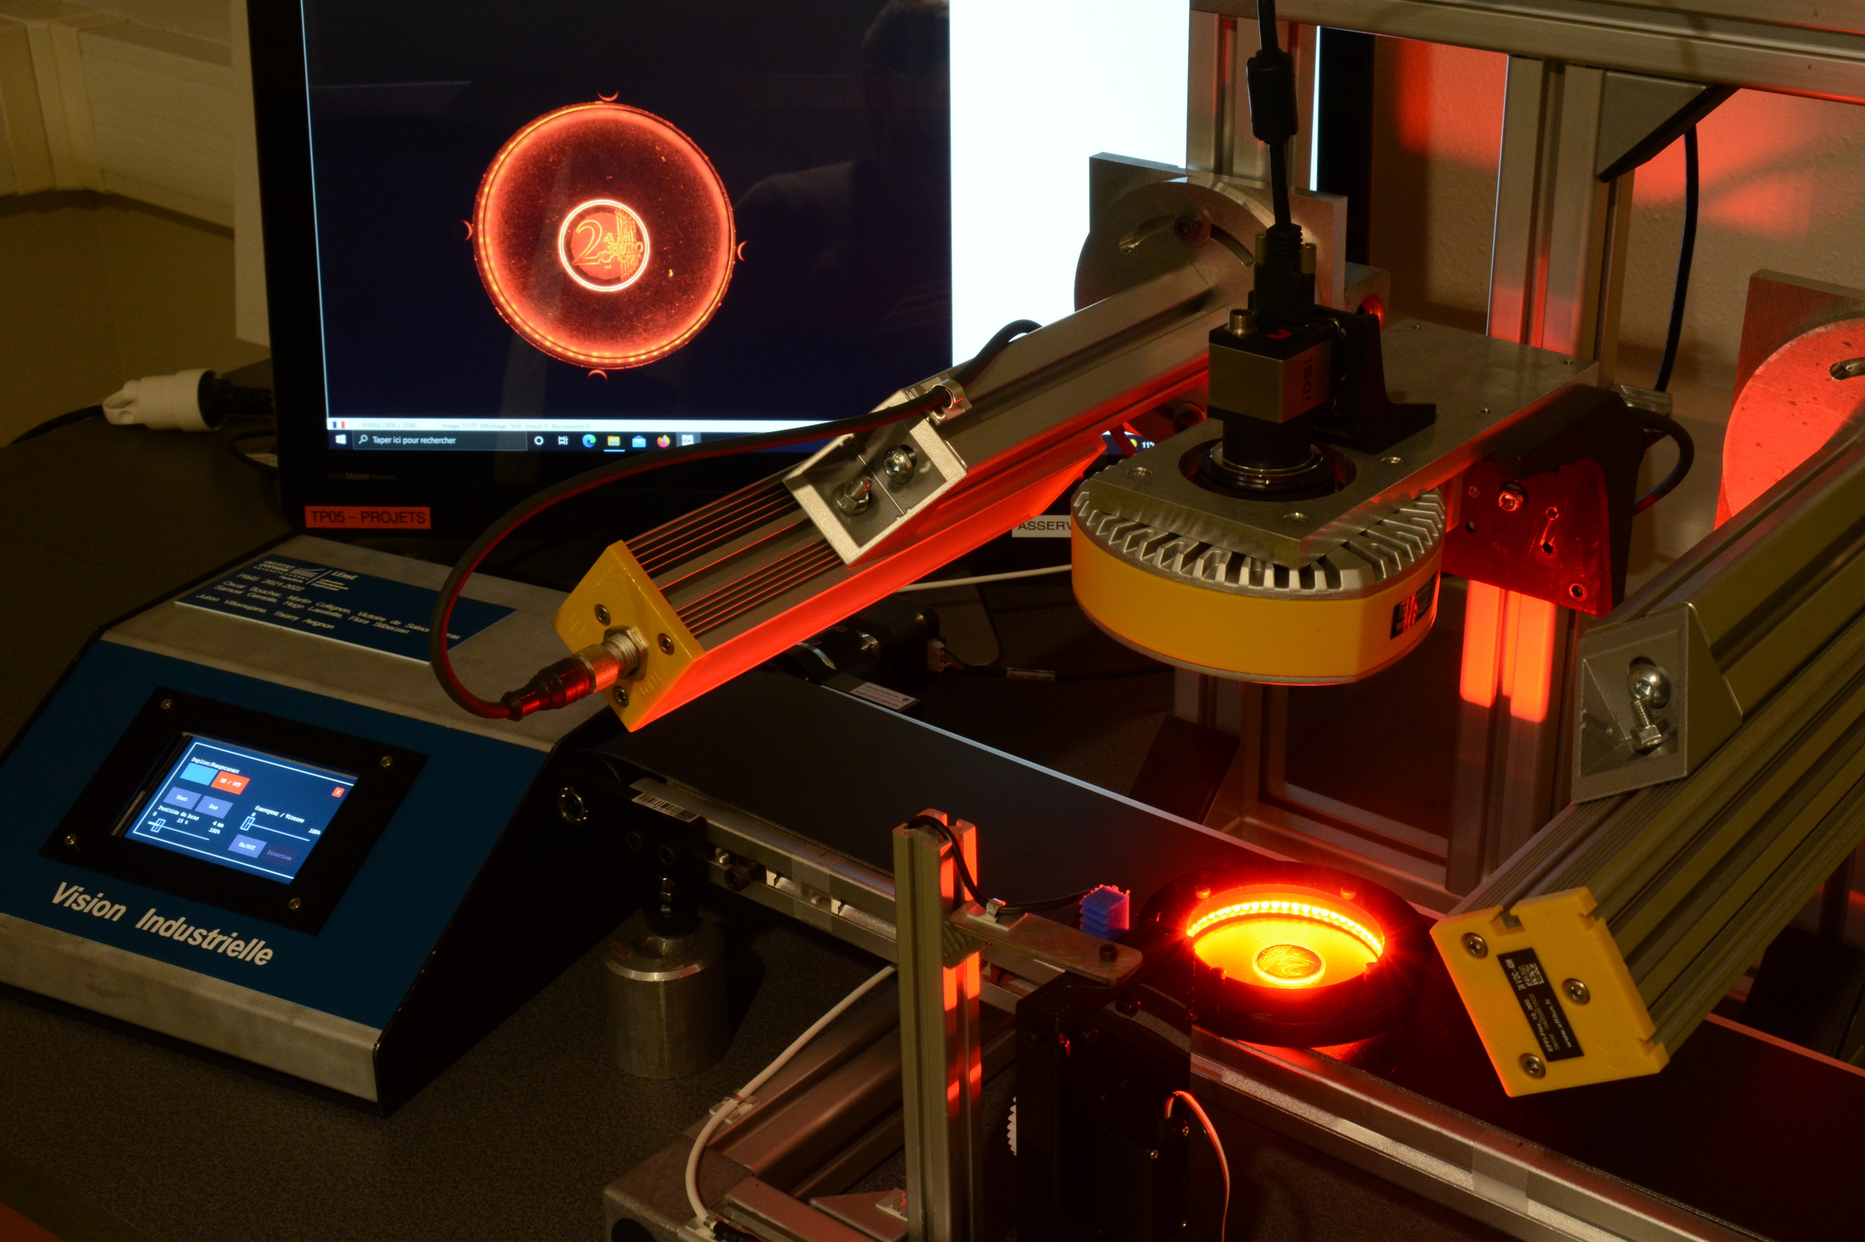
Image processing
Goal of processing an image
Image from the camera
Noise
Bad contrast
Inhomogeneous Lighting
…
Desired image with objects with well-defined contours
Homogeneous zones
Transition zones
Notes:
In a machine vision inspection application, the image processing pipeline involves a series of steps that transform raw image data into meaningful decisions about product quality or other criteria. Here’s an overview of the main steps from capturing the image to making a decision:
### 1. **Image Acquisition**
- **Camera Setup**: A camera captures images of the product or material. This could involve multiple cameras or 3D sensors, depending on the application.
- **Lighting Control**: Appropriate lighting ensures consistent and accurate image capture, helping highlight defects or features.
- **Triggering**: The image is typically captured when the product reaches a specific point on a conveyor belt (triggered by sensors).
### 2. **Preprocessing**
- **Noise Reduction**: Filters are applied to reduce noise in the image (e.g., smoothing, Gaussian filters), ensuring clarity and reducing unwanted information.
- **Contrast Enhancement**: Adjusting the image contrast or brightness to make features of interest stand out.
- **Normalization**: Standardizing the image scale or intensity to create consistency across multiple images for easier analysis.
### 3. **Segmentation**
- **Thresholding**: Convert the image to a binary or multi-level image to isolate objects or regions of interest (e.g., separate a product from the background).
- **Edge Detection**: Detect the edges of objects or features in the image, which is useful for identifying boundaries and contours.
- **Region of Interest (ROI) Selection**: Select specific areas of the image for further processing, focusing only on relevant portions of the image.
### 4. **Feature Extraction**
- **Geometric Features**: Extract measurements like size, shape, position, orientation, and symmetry from the segmented objects.
- **Texture Analysis**: Analyze the texture patterns for roughness, uniformity, etc., to assess the surface quality.
- **Color Analysis**: Extract color information for color-based inspection, ensuring the correct color is used or verifying its consistency.
- **Pattern Recognition**: Recognize patterns, symbols, or specific features to classify parts or detect defects.
### 5. **Object Detection and Classification**
- **Object Detection**: Identify and label objects within the image to confirm their presence or detect defects.
- **Template Matching**: Match the object or part in the image against a predefined template to check for correct shape, size, and orientation.
- **Classification**: Based on the extracted features, classify the objects as good, bad, or categorize them into specific groups (e.g., defective or non-defective).
### 6. **Decision Making**
- **Comparison Against Tolerances**: The extracted measurements, shapes, and features are compared against predefined tolerances or quality standards.
- **Pass/Fail Decision**: Based on the comparison, a decision is made whether the product meets the required quality standards. If it fails, the system can trigger corrective actions (e.g., rejecting the item or sending it for rework).
- **Real-time Feedback**: Provide real-time feedback to the production system to either pass or reject the part or trigger alarms if defects are detected.
### 7. **Post-processing and Output**
- **Data Logging**: Record the inspection data and images for further analysis or auditing purposes.
- **Output to Control Systems**: The decision is communicated to automated systems such as conveyor belts, robotic arms, or quality control stations to handle the product accordingly.
- **Operator Interface**: The results and images are often displayed on a graphical interface for human operators to monitor the process.
### 8. **Feedback and Learning (Optional)**
- In some advanced systems, **machine learning** or **AI algorithms** are used to adapt and improve decision-making over time by learning from previous images and inspection outcomes.
This image processing pipeline ensures fast, accurate, and repeatable inspection in manufacturing environments, reducing human error and improving overall product quality.

Slide 3
Image processing
Acquisition
Steps for processing an image
Pre Processing
Light, Camera…
Noise Reduction / Filtering
Contrast Enhancement
Normalization
Ensuring clarity and reducing unwanted information
Making features of interest stand out
Standardizing the image scale or intensity
Segmentation
Thresholding
Edge Detection
Region of Interest Selection
Isolating objects of ROI / Separating product from background
Identifying boundaries and contours
Focusing only on relevant portions of the image
Feature Extraction
Geometric Features
Texture Analysis
Color Analysis
Extracting measurements (size, shape, position…)
Recognizing patterns, symbols, points of interest
Classification
Object detection
Template Matching
Classification
Identifying and labelling objects
Checking correct shape, size or orientation
Categorizing objects to specific groups (defective or non-def.)
Decision
Tolerances, pass/fail, real-time feedback…
Notes:
In a machine vision inspection application, the image processing pipeline involves a series of steps that transform raw image data into meaningful decisions about product quality or other criteria. Here’s an overview of the main steps from capturing the image to making a decision:
### 1. **Image Acquisition**
- **Camera Setup**: A camera captures images of the product or material. This could involve multiple cameras or 3D sensors, depending on the application.
- **Lighting Control**: Appropriate lighting ensures consistent and accurate image capture, helping highlight defects or features.
- **Triggering**: The image is typically captured when the product reaches a specific point on a conveyor belt (triggered by sensors).
### 2. **Preprocessing**
- **Noise Reduction**: Filters are applied to reduce noise in the image (e.g., smoothing, Gaussian filters), ensuring clarity and reducing unwanted information.
- **Contrast Enhancement**: Adjusting the image contrast or brightness to make features of interest stand out.
- **Normalization**: Standardizing the image scale or intensity to create consistency across multiple images for easier analysis.
### 3. **Segmentation**
- **Thresholding**: Convert the image to a binary or multi-level image to isolate objects or regions of interest (e.g., separate a product from the background).
- **Edge Detection**: Detect the edges of objects or features in the image, which is useful for identifying boundaries and contours.
- **Region of Interest (ROI) Selection**: Select specific areas of the image for further processing, focusing only on relevant portions of the image.
### 4. **Feature Extraction**
- **Geometric Features**: Extract measurements like size, shape, position, orientation, and symmetry from the segmented objects.
- **Texture Analysis**: Analyze the texture patterns for roughness, uniformity, etc., to assess the surface quality.
- **Color Analysis**: Extract color information for color-based inspection, ensuring the correct color is used or verifying its consistency.
- **Pattern Recognition**: Recognize patterns, symbols, or specific features to classify parts or detect defects.
### 5. **Object Detection and Classification**
- **Object Detection**: Identify and label objects within the image to confirm their presence or detect defects.
- **Template Matching**: Match the object or part in the image against a predefined template to check for correct shape, size, and orientation.
- **Classification**: Based on the extracted features, classify the objects as good, bad, or categorize them into specific groups (e.g., defective or non-defective).
### 6. **Decision Making**
- **Comparison Against Tolerances**: The extracted measurements, shapes, and features are compared against predefined tolerances or quality standards.
- **Pass/Fail Decision**: Based on the comparison, a decision is made whether the product meets the required quality standards. If it fails, the system can trigger corrective actions (e.g., rejecting the item or sending it for rework).
- **Real-time Feedback**: Provide real-time feedback to the production system to either pass or reject the part or trigger alarms if defects are detected.
### 7. **Post-processing and Output**
- **Data Logging**: Record the inspection data and images for further analysis or auditing purposes.
- **Output to Control Systems**: The decision is communicated to automated systems such as conveyor belts, robotic arms, or quality control stations to handle the product accordingly.
- **Operator Interface**: The results and images are often displayed on a graphical interface for human operators to monitor the process.
### 8. **Feedback and Learning (Optional)**
- In some advanced systems, **machine learning** or **AI algorithms** are used to adapt and improve decision-making over time by learning from previous images and inspection outcomes.
This image processing pipeline ensures fast, accurate, and repeatable inspection in manufacturing environments, reducing human error and improving overall product quality.

Slide 4
Digital Images and Processing
Institut d’Optique – Engineers Training
Semester 6 – Digital Interface
Julien VILLEMEJANE

Slide 5
Image processing with OpenCV
Digital Images / Resolution
B
1
2
3
4
GrayScale
Nb of pixels = h x v
Columns
G
1
2
3
4
AOP
R
1
1
Rows
2
2
3
3

Slide 6
Image processing with OpenCV
Digital Images / Depth
B
1
2
3
4
GrayScale
Nb of pixels = h x v
Columns
G
1
2
3
4
AOP
R
1
1
Rows
2
2
3
$$0≤R≤255$$
3
$$0≤G≤255$$
RGB : 3 channels of 8 bits
$$0≤B≤255$$
Each pixel is converted into n bits.
R=200, G=100, G=50

Slide 7
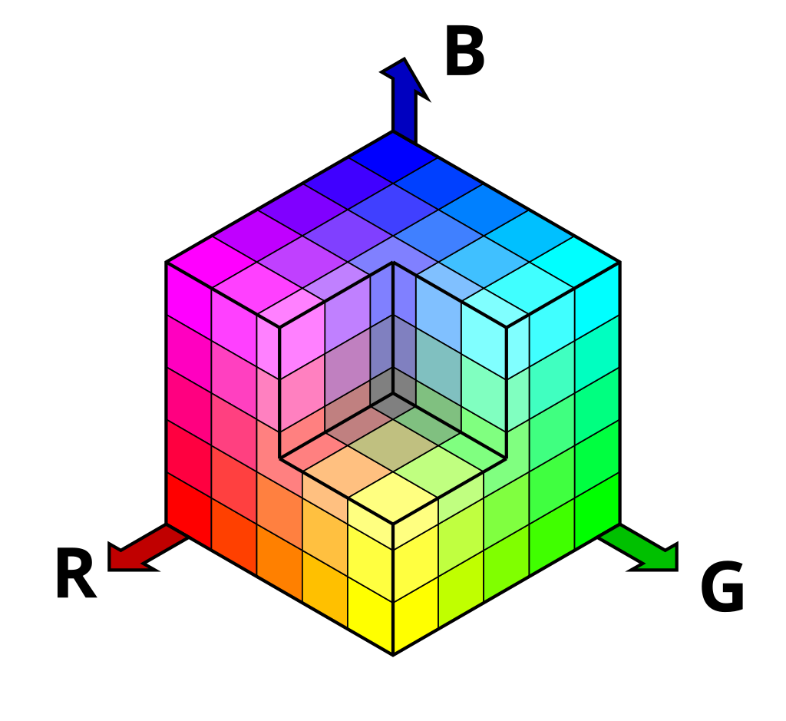
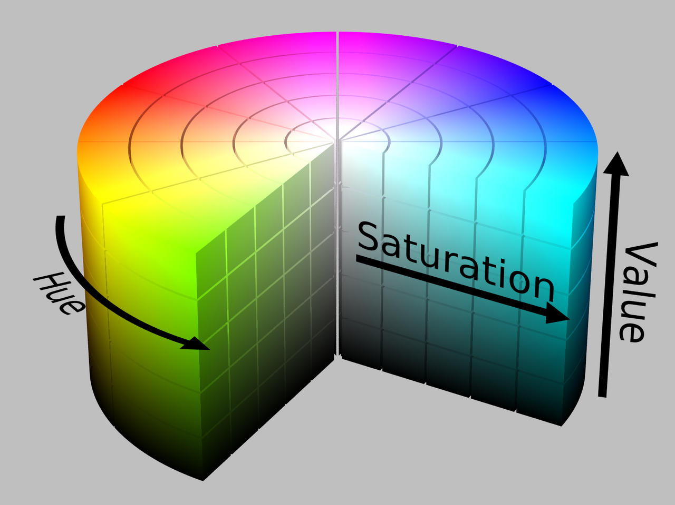
Image processing with OpenCV
Digital Images / Color Spaces
RGB
Color Space
Used primarily in electronic displays like computer screens, cameras, and scanners. The combination of these three primary colors at various intensities can produce any color.
Model for representing colors in a consistent and reproducible way
Each color space uses a different method for organizing and describing color, depending on the purpose or application
HSV
Used in image editing. It separates image’s color from its brightness.
Hue : type of color
Saturation : intensity of the color
Value : Brightness of the color
CMYK
LAB
YUV
Images Source : Wikipedia

Slide 8
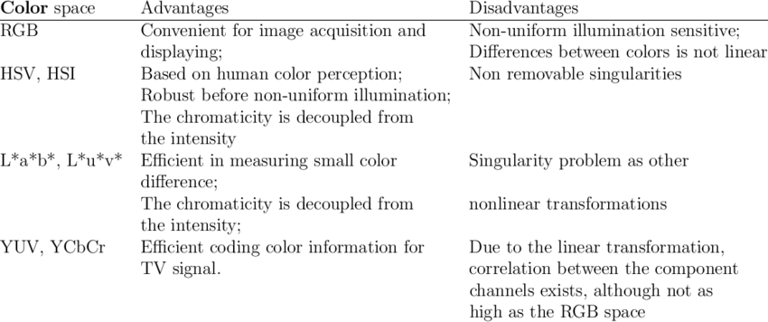
Image processing with OpenCV
Digital Images / Color Spaces
Color Space
Table 9 from
Segmentation of Images by Color Features: A Survey - Scientific Figure on ResearchGate. Available from: https://www.researchgate.net/figure/Advantages-and-disadvantages-of-color-spaces_tbl7_323632019 [accessed 10 Oct 2024]
Model for representing colors in a consistent and reproducible way

Slide 9
Image processing with OpenCV
Acquisition
Pre-Processing
Pre Processing
Noise Reduction / Filtering
Contrast Enhancement
Normalization
Ensuring clarity and reducing unwanted information
Making features of interest stand out
Standardizing the image scale or intensity

Slide 10
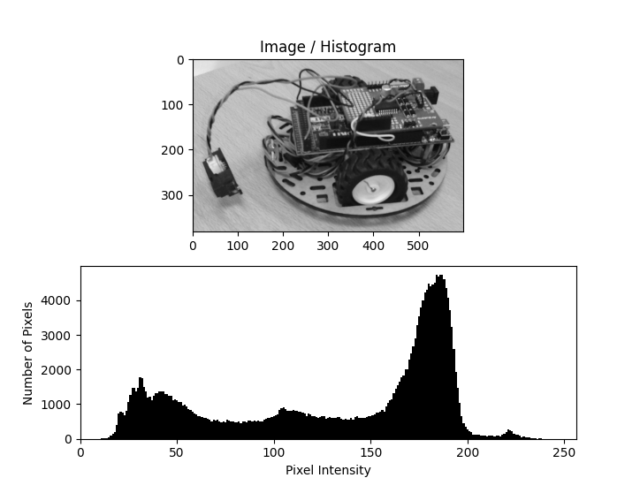
Image processing with OpenCV
Acquisition
OpenCV / Histogram of an image
Pre Processing
Histogram
Graphical representation that shows the distribution of pixel intensity values in an image

Slide 11
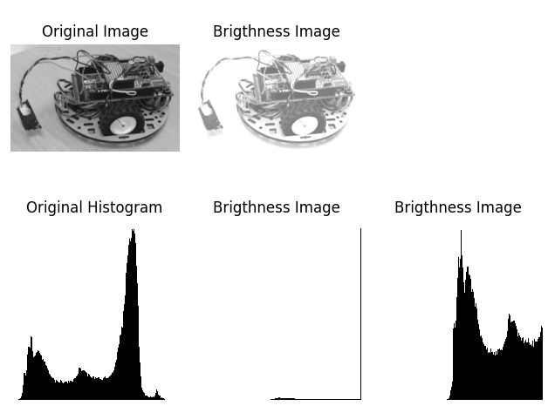
Image processing with OpenCV
Acquisition
OpenCV / Contrast and Brightness
Pre Processing
+ 100
+ 100
+ 100
+ 100
new_img = cv2.convertScaleAbs(image, beta=100)

Slide 12
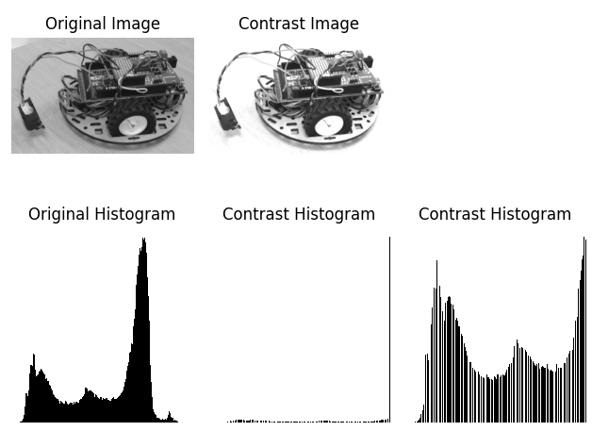
Image processing with OpenCV
Acquisition
OpenCV / Contrast and Brightness
Pre Processing
x 1.5
x 1.5
x 1.5
x 1.5
new_img = cv2.convertScaleAbs(image, alpha=1.5)

Slide 13
Image processing with OpenCV
Acquisition
OpenCV / Convolution
Pre Processing
5
8
4
2
3
1
5
Convolution (filter)
9
5
1
8
7
6
2
-1
0
-2
x
x
x
5
7
1
5
6
8
7
1
5
1
x
x
x
kernel
5
8
2
8
4
3
3
-2
0
-1
x
x
x
-1
0
-2
original image
5
6
6
7
2
5
1
1
5
1
5
8
4
2
3
1
5
filtered image
R = -8 + 0 – 12 + 5 + 30 + 8 – 16 + 0 – 3
R = 4
-2
0
-1
9
5
1
8
7
6
2
5
7
1
5
6
8
7
5
8
2
8
4
3
3
4
5
6
6
7
2
5
1

Slide 14
Image processing with OpenCV
Acquisition
OpenCV / Convolution Kernel (or Structuring Element)
Pre Processing
kernel = cv2.getStructuringElement(cv2.MORPH_xx, (M,N))
Cross Kernel
Rect Kernel
0
0
1
0
0
1
1
1
1
1
0
0
1
0
0
1
1
1
1
1
1
1
1
1
1
1
1
1
1
1
0
0
1
0
0
1
1
1
1
1
0
0
1
0
0
1
1
1
1
1
cv2.MORPH_CROSS
cv2.MORPH_RECT

Slide 15
Image processing with OpenCV
Acquisition
OpenCV / Erosion and Dilation
Pre Processing
Original pixels
Removed pixels
Added pixels
kernel
Erosion
Dilation
0
1
0
Shrinking the foreground by removing pixels to the boundaries of objects
Enlarging the foreground by adding pixels to the boundaries of objects
1
1
1
0
1
0
https://www.youtube.com/watch?v=fmyE7DiaIYQ
https://www.youtube.com/watch?v=xO3ED27rMHs

Slide 16
Image processing with OpenCV
OpenCV / Erosion and Dilation - EXERCICES
Erosion
CROSS
CORNER

Slide 17
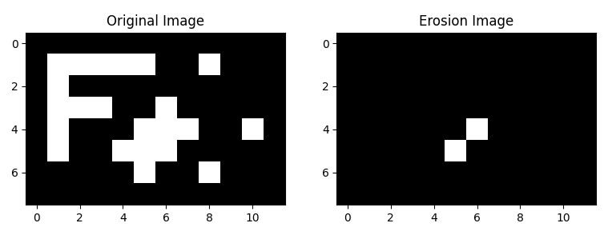
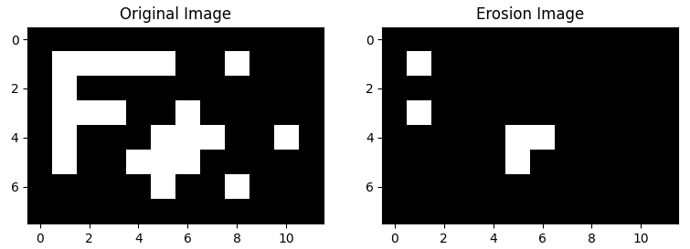
Image processing with OpenCV
OpenCV / Erosion and Dilation - REPONSES
Erosion
CROSS
CORNER

Slide 18
Image processing with OpenCV
OpenCV / Erosion and Dilation - EXERCICES
Erosion
KERNEL ??
How to design a kernel to detect horizontal lines ?

Slide 19
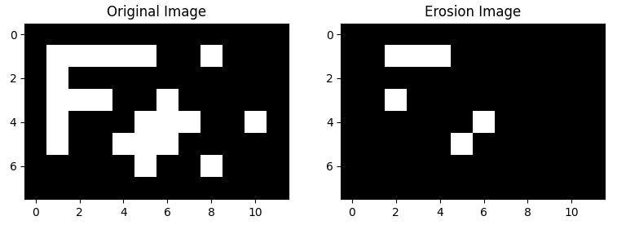
Image processing with OpenCV
OpenCV / Erosion and Dilation - REPONSES
Erosion
KERNEL

Slide 20
Image processing with OpenCV
OpenCV / Erosion and Dilation - EXERCICES
Dilation
KER 1
KER 2

Slide 21
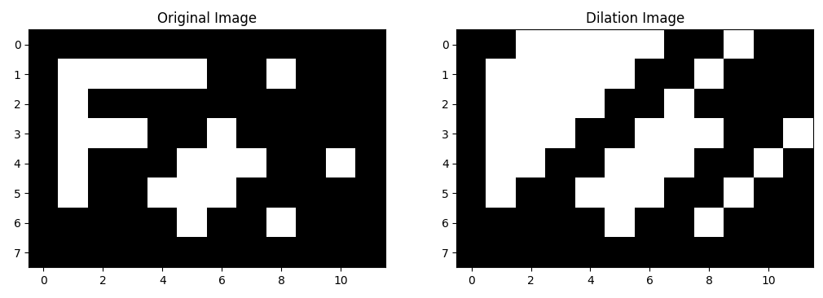
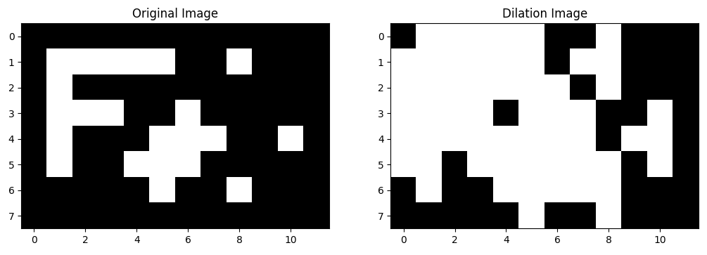
Image processing with OpenCV
OpenCV / Erosion and Dilation - REPONSES
Erosion
KER 1
KER 2

Slide 22
Image processing with OpenCV
Acquisition
OpenCV / Erosion and Dilation
Pre Processing
kernel
Erosion
Dilation
0
1
0
Shrinking the foreground by removing pixels to the boundaries of objects
Enlarging the foreground by adding pixels to the boundaries of objects
1
1
1
0
1
0
eroded_image = cv2.erode(image, kernel, iterations=1)
dilated_image = cv2.dilate(image, kernel, iterations=1)

Slide 23
Image processing with OpenCV
Acquisition
OpenCV / Opening and Closing morphological transforms
Pre Processing
kernel
Opening
Closing
0
1
0
Erosion then Dilation
Removing small objects, in the background
Dilation then Erosion
Filling in small holes in the foreground
1
1
1
0
1
0
opening_image = cv2.morphologyEx(image, cv2.MORPH_OPEN, kernel)
closing_image = cv2.morphologyEx(image, cv2.MORPH_CLOSE, kernel)

Slide 24
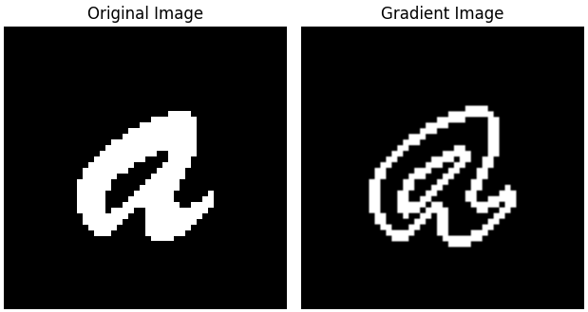
Image processing with OpenCV
Acquisition
OpenCV / Gradient morphological transforms
Pre Processing
kernel
Gradient
0
1
0
Difference between a dilation and an erosion
Unknown pixels classification : background or foreground ?
1
1
1
0
1
0
gradient_image = cv2.morphologyEx(image, cv2.MORPH_GRADIENT, kernel)

Slide 25
cv2.imshow('Image Window', image)
Image processing with OpenCV
Acquisition
OpenCV / Blur and mean
Pre Processing
kernel_size = (N,M)
blurred_image_gauss = cv2.GaussianBlur(image, kernel_size, 0)
blurred_image_box = cv2.blur(image, kernel_size)
1
4
7
4
1
Mean Kernel ( x 1/(N*M) )
Gaussian Kernel
(x 1/273)
4
16
26
16
4
1/9
1/9
1/9
7
26
41
26
7
1/9
1/9
1/9
Removing irrelevant details
4
16
26
16
4
1/9
1/9
1/9
1
4
7
4
1

Slide 26
Image processing
Acquisition
Goal of processing an image
Pre Processing
https://docs.opencv.org/4.x/d3/db4/tutorial_py_watershed.html
Segmentation
Thresholding
Edge Detection
Region of Interest Selection
Isolating objects of ROI / Separating product from background
Identifying boundaries and contours
Focusing only on relevant portions of the image
Feature Extraction
Geometric Features
Texture Analysis
Color Analysis
Extracting measurements (size, shape, position…)
Recognizing patterns, symbols, points of interest
Notes:
In a machine vision inspection application, the image processing pipeline involves a series of steps that transform raw image data into meaningful decisions about product quality or other criteria. Here’s an overview of the main steps from capturing the image to making a decision:
### 1. **Image Acquisition**
- **Camera Setup**: A camera captures images of the product or material. This could involve multiple cameras or 3D sensors, depending on the application.
- **Lighting Control**: Appropriate lighting ensures consistent and accurate image capture, helping highlight defects or features.
- **Triggering**: The image is typically captured when the product reaches a specific point on a conveyor belt (triggered by sensors).
### 2. **Preprocessing**
- **Noise Reduction**: Filters are applied to reduce noise in the image (e.g., smoothing, Gaussian filters), ensuring clarity and reducing unwanted information.
- **Contrast Enhancement**: Adjusting the image contrast or brightness to make features of interest stand out.
- **Normalization**: Standardizing the image scale or intensity to create consistency across multiple images for easier analysis.
### 3. **Segmentation**
- **Thresholding**: Convert the image to a binary or multi-level image to isolate objects or regions of interest (e.g., separate a product from the background).
- **Edge Detection**: Detect the edges of objects or features in the image, which is useful for identifying boundaries and contours.
- **Region of Interest (ROI) Selection**: Select specific areas of the image for further processing, focusing only on relevant portions of the image.
### 4. **Feature Extraction**
- **Geometric Features**: Extract measurements like size, shape, position, orientation, and symmetry from the segmented objects.
- **Texture Analysis**: Analyze the texture patterns for roughness, uniformity, etc., to assess the surface quality.
- **Color Analysis**: Extract color information for color-based inspection, ensuring the correct color is used or verifying its consistency.
- **Pattern Recognition**: Recognize patterns, symbols, or specific features to classify parts or detect defects.
### 5. **Object Detection and Classification**
- **Object Detection**: Identify and label objects within the image to confirm their presence or detect defects.
- **Template Matching**: Match the object or part in the image against a predefined template to check for correct shape, size, and orientation.
- **Classification**: Based on the extracted features, classify the objects as good, bad, or categorize them into specific groups (e.g., defective or non-defective).
### 6. **Decision Making**
- **Comparison Against Tolerances**: The extracted measurements, shapes, and features are compared against predefined tolerances or quality standards.
- **Pass/Fail Decision**: Based on the comparison, a decision is made whether the product meets the required quality standards. If it fails, the system can trigger corrective actions (e.g., rejecting the item or sending it for rework).
- **Real-time Feedback**: Provide real-time feedback to the production system to either pass or reject the part or trigger alarms if defects are detected.
### 7. **Post-processing and Output**
- **Data Logging**: Record the inspection data and images for further analysis or auditing purposes.
- **Output to Control Systems**: The decision is communicated to automated systems such as conveyor belts, robotic arms, or quality control stations to handle the product accordingly.
- **Operator Interface**: The results and images are often displayed on a graphical interface for human operators to monitor the process.
### 8. **Feedback and Learning (Optional)**
- In some advanced systems, **machine learning** or **AI algorithms** are used to adapt and improve decision-making over time by learning from previous images and inspection outcomes.
This image processing pipeline ensures fast, accurate, and repeatable inspection in manufacturing environments, reducing human error and improving overall product quality.

Slide 27
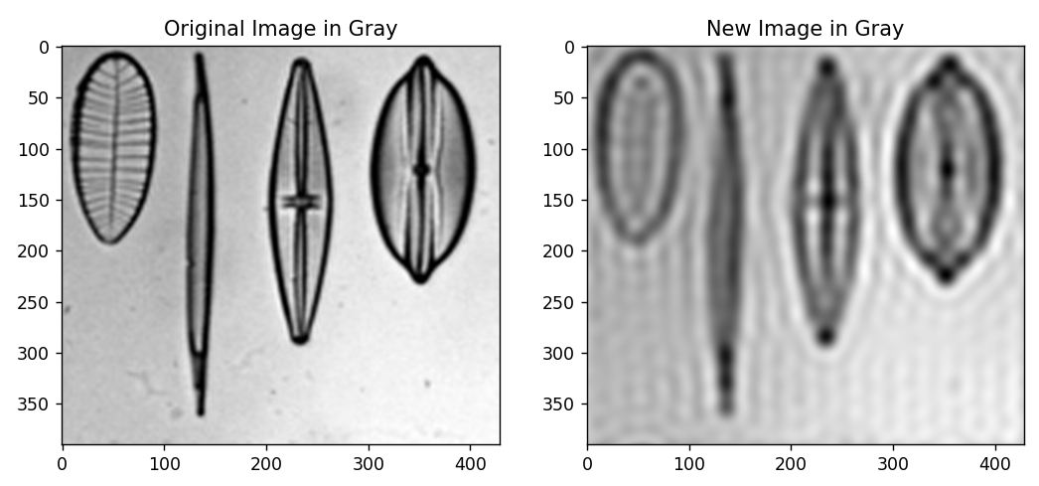
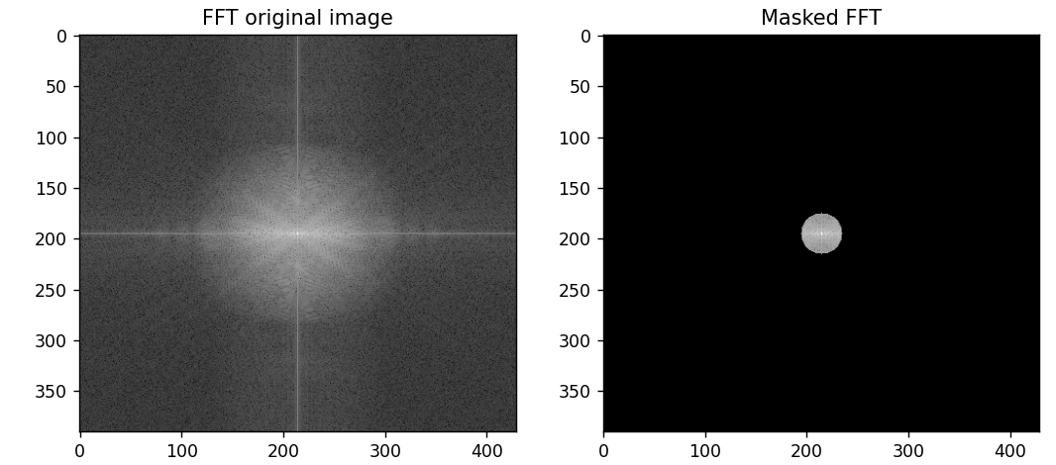
Image processing
Acquisition
Fourier Transform and filtering
Pre Processing
Segmentation
Feature Extraction
Notes:
In a machine vision inspection application, the image processing pipeline involves a series of steps that transform raw image data into meaningful decisions about product quality or other criteria. Here’s an overview of the main steps from capturing the image to making a decision:
### 1. **Image Acquisition**
- **Camera Setup**: A camera captures images of the product or material. This could involve multiple cameras or 3D sensors, depending on the application.
- **Lighting Control**: Appropriate lighting ensures consistent and accurate image capture, helping highlight defects or features.
- **Triggering**: The image is typically captured when the product reaches a specific point on a conveyor belt (triggered by sensors).
### 2. **Preprocessing**
- **Noise Reduction**: Filters are applied to reduce noise in the image (e.g., smoothing, Gaussian filters), ensuring clarity and reducing unwanted information.
- **Contrast Enhancement**: Adjusting the image contrast or brightness to make features of interest stand out.
- **Normalization**: Standardizing the image scale or intensity to create consistency across multiple images for easier analysis.
### 3. **Segmentation**
- **Thresholding**: Convert the image to a binary or multi-level image to isolate objects or regions of interest (e.g., separate a product from the background).
- **Edge Detection**: Detect the edges of objects or features in the image, which is useful for identifying boundaries and contours.
- **Region of Interest (ROI) Selection**: Select specific areas of the image for further processing, focusing only on relevant portions of the image.
### 4. **Feature Extraction**
- **Geometric Features**: Extract measurements like size, shape, position, orientation, and symmetry from the segmented objects.
- **Texture Analysis**: Analyze the texture patterns for roughness, uniformity, etc., to assess the surface quality.
- **Color Analysis**: Extract color information for color-based inspection, ensuring the correct color is used or verifying its consistency.
- **Pattern Recognition**: Recognize patterns, symbols, or specific features to classify parts or detect defects.
### 5. **Object Detection and Classification**
- **Object Detection**: Identify and label objects within the image to confirm their presence or detect defects.
- **Template Matching**: Match the object or part in the image against a predefined template to check for correct shape, size, and orientation.
- **Classification**: Based on the extracted features, classify the objects as good, bad, or categorize them into specific groups (e.g., defective or non-defective).
### 6. **Decision Making**
- **Comparison Against Tolerances**: The extracted measurements, shapes, and features are compared against predefined tolerances or quality standards.
- **Pass/Fail Decision**: Based on the comparison, a decision is made whether the product meets the required quality standards. If it fails, the system can trigger corrective actions (e.g., rejecting the item or sending it for rework).
- **Real-time Feedback**: Provide real-time feedback to the production system to either pass or reject the part or trigger alarms if defects are detected.
### 7. **Post-processing and Output**
- **Data Logging**: Record the inspection data and images for further analysis or auditing purposes.
- **Output to Control Systems**: The decision is communicated to automated systems such as conveyor belts, robotic arms, or quality control stations to handle the product accordingly.
- **Operator Interface**: The results and images are often displayed on a graphical interface for human operators to monitor the process.
### 8. **Feedback and Learning (Optional)**
- In some advanced systems, **machine learning** or **AI algorithms** are used to adapt and improve decision-making over time by learning from previous images and inspection outcomes.
This image processing pipeline ensures fast, accurate, and repeatable inspection in manufacturing environments, reducing human error and improving overall product quality.

