Slide 1
Python / Numpy Array
Digital Methods Institut d’Optique / Notions

Slide 2
How to create an array ?
For scientific purpose
Bad method (using List)
Good method (using Array)
N = 10
vect = []
for i in range(N):
vect.append(0)
import numpy as np
N = 10
vect = np.zeros(N)
print(type(vect))
print(type(vect))
<class ‘list’>
<class ‘numpy.ndarray’>
Temps exécution :
N=10 ~1 us
N=1000 ~100 us
Temps exécution :
N=10 ~0,25 us
N=1000 ~0,6 us
Exécution : Core(TM) i7-9750H CPU @ 2.60GHz / 32 Go RAM

Slide 3
How to create an array ?
For scientific purpose
1D array
Ones or zeros array
Linear/Logarithmic distribution
2D array
Ones or zeros array
Meshgrid
import numpy as np
N = 10
vect0 = np.zeros(N)
vect1 = np.ones(N)
import numpy as np
N, M = 10, 20
vect = np.zeros((N,M))
vect_lin1 = np.linspace(start, stop, nb)
x = np.linspace(0, M-1, M)
y = np.linspace(0, N-1, N)
XX, YY = np.meshgrid(x, y)
vect_log = np.logspace(dec_start, dec_stop, nb)
vect_lin2 = np.arange(start, stop, step)

Slide 4
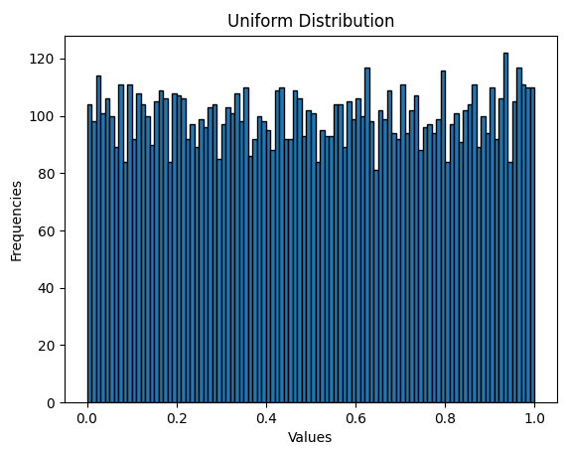
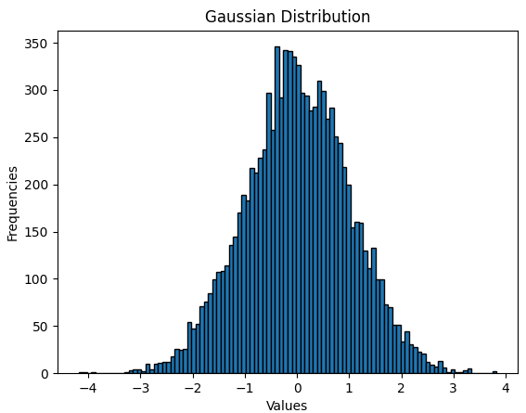
How to create an array ?
For scientific purpose
Random array
Uniform distribution
Gaussian/normal distribution
Integer (uniform distribution)
import numpy as np
data = np.random.rand(1000,5)
print(data.shape)
array = np.random.randint(1, 100, size=(5, 5))
(1000, 5)
data = np.random.randn(1000,5)

Slide 5
How to fill an array ?
For scientific purpose
data = np.random.randn(100,5)
Bad method (using List)
Good method (using Array)
v1 = []
v2 = []
for i in range(len(data)):
v1.append(data[i, 1])
v2.append(data[i, 2])
v1 = data(:, 1)
v2 = data(:, 2)
An array is not a simple list !
or
v1_b = [data[i, 1] for i in range(len(data))]
Temps exécution :
~400 us
Temps exécution :
~0,5 us
Exécution : Core(TM) i7-9750H CPU @ 2.60GHz / 32 Go RAM

Slide 6
Conditionals on array
For scientific purpose
data = np.random.randint(0, 10, size=(10))
Finding elements
Filtering elements
k = ((data >= 4) & (data < 8))
print(data)
print(k)
arr = np.array([1, 2, 3, 4, 5, 6])
filtered_arr = arr[arr > 3]
print(filtered_arr)
[6 0 3 8 7 4 6 8 3 8]
[4 5 6]
[ True False False False True True True False False False]
data2 = k * data
[6 0 0 0 7 4 6 0 0 0]

