Slide 1
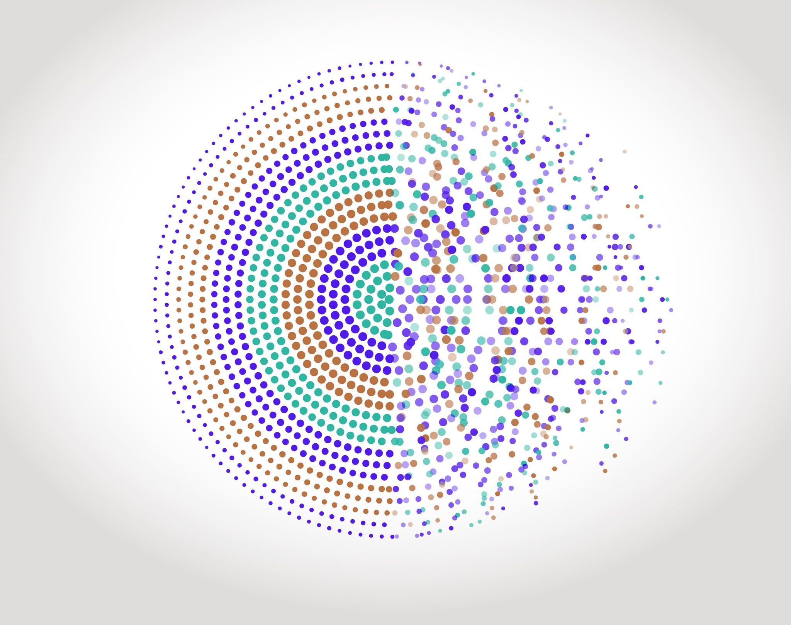
Python / Numpy Meshgrid
Digital Methods Institut d’Optique / Notions

Slide 2
How to fill a 2D array ?
Problem :
Fill a 2D array with a specific value depending on x-axis and y-axis index
x[0]
x[1]
x[i]
x[M-1]
x
For example :
y[0]
def F(a, b):
return a + b
F ( x(j), y(i) )
y[1]
y[j]
y[N-1]
We assume that x and y are defined :
y
x = np.arange(…) # length = M
y = np.arange(…) # length = N

Slide 3
How to fill a 2D array ?
First idea : a double loop on i and j
output_array = np.zeros((N, M))
for i in range(N):
for j in range(M):
output_array[i][j] = F(x[j], y[i])

Slide 4
How to fill a 2D array ?
x = np.linspace(0, M-1, M)
y = np.linspace(0, N-1, N)
Example (N and M are integers) :
def F(a, b):
return a + b
output_array = np.zeros((N, M))
for i in range(N):
for j in range(M):
output_array[i][j] = F(x[j], y[i])
x[0]
x[1]
x[i]
x[M-1]
x
y[0]
0
0
0
0
0
0
y[1]
0
0
0
0
0
0
y[j]
0
0
0
0
0
0
y[N-1]
0
0
0
0
0
0
y

Slide 5
How to fill a 2D array ?
x = np.linspace(0, M-1, M)
y = np.linspace(0, N-1, N)
Example (N and M are integers) :
def F(a, b):
return a + b
output_array = np.zeros((N, M))
for i in range(N):
for j in range(M):
output_array[i][j] = F(x[j], y[i])
x[0]
x[1]
x[i]
x[M-1]
x
i = 0
0
0
0
0
0
0
y[0]
y[1]
0
0
0
0
0
0
y[j]
0
0
0
0
0
0
y[N-1]
0
0
0
0
0
0
y

Slide 6
How to fill a 2D array ?
x = np.linspace(0, M-1, M)
y = np.linspace(0, N-1, N)
Example (N and M are integers) :
def F(a, b):
return a + b
output_array = np.zeros((N, M))
for i in range(N):
for j in range(M):
output_array[i][j] = F(x[j], y[i])
x[0]
x[1]
x[i]
x[M-1]
x
i = 0
j = 0 → ouput_array[0][0] = F(x[0], y[0]) = 0
0
0
0
0
0
0
y[0]
y[1]
0
0
0
0
0
0
y[j]
0
0
0
0
0
0
y[N-1]
0
0
0
0
0
0
y

Slide 7
How to fill a 2D array ?
x = np.linspace(0, M-1, M)
y = np.linspace(0, N-1, N)
Example (N and M are integers) :
def F(a, b):
return a + b
output_array = np.zeros((N, M))
for i in range(N):
for j in range(M):
output_array[i][j] = F(x[j], y[i])
x[0]
x[1]
x[i]
x[M-1]
x
i = 0
j = 0 → ouput_array[0][0] = F(x[0], y[0]) = 0
j = 1 → ouput_array[0][1] = F(x[1], y[0]) = 1
0
1
0
0
0
0
y[0]
y[1]
0
0
0
0
0
0
y[j]
0
0
0
0
0
0
y[N-1]
0
0
0
0
0
0
y

Slide 8
How to fill a 2D array ?
x = np.linspace(0, M-1, M)
y = np.linspace(0, N-1, N)
Example (N and M are integers) :
def F(a, b):
return a + b
output_array = np.zeros((N, M))
for i in range(N):
for j in range(M):
output_array[i][j] = F(x[j], y[i])
x[0]
x[1]
x[i]
x[M-1]
x
i = 0
j = 0 → ouput_array[0][0] = F(x[0], y[0]) = 0
j = 1 → ouput_array[0][1] = F(x[1], y[0]) = 1
j = 2 → ouput_array[0][2] = F(x[2], y[0]) = 2
j = 3 → ouput_array[0][3] = F(x[3], y[0]) = 3
j = 4 → ouput_array[0][4] = F(x[4], y[0]) = 4
j = 5 → ouput_array[0][5] = F(x[5], y[0]) = 5
0
1
2
3
4
5
y[0]
y[1]
0
0
0
0
0
0
y[j]
0
0
0
0
0
0
y[N-1]
0
0
0
0
0
0
y

Slide 9
How to fill a 2D array ?
x = np.linspace(0, M-1, M)
y = np.linspace(0, N-1, N)
Example (N and M are integers) :
def F(a, b):
return a + b
output_array = np.zeros((N, M))
for i in range(N):
for j in range(M):
output_array[i][j] = F(x[j], y[i])
x[0]
x[1]
x[i]
x[M-1]
x
i = 0
…
i = 1
j = 0 → ouput_array[1][0] = F(x[0], y[1]) = 1
0
1
2
3
4
5
y[0]
y[1]
1
0
0
0
0
0
y[j]
0
0
0
0
0
0
y[N-1]
0
0
0
0
0
0
y

Slide 10
How to fill a 2D array ?
x = np.linspace(0, M-1, M)
y = np.linspace(0, N-1, N)
Example (N and M are integers) :
def F(a, b):
return a + b
output_array = np.zeros((N, M))
for i in range(N):
for j in range(M):
output_array[i][j] = F(x[j], y[i])
x[0]
x[1]
x[i]
x[M-1]
x
i = 0
…
i = 1
j = 0 → ouput_array[1][0] = F(x[0], y[1]) = 1
j = 1 → ouput_array[1][1] = F(x[1], y[1]) = 2
0
1
2
3
4
5
y[0]
y[1]
1
2
0
0
0
0
y[j]
0
0
0
0
0
0
y[N-1]
0
0
0
0
0
0
y

Slide 11
How to fill a 2D array ?
Second method : using Numpy arrays methods (meshgrid)
XX, YY = np.meshgrid(x, y)
output_array = F(YY, XX)

Slide 12
How to fill a 2D array ?
x = np.linspace(0, M-1, M)
y = np.linspace(0, N-1, N)
Example (N and M are integers) :
def F(a, b):
return a + b
XX, YY = np.meshgrid(x, y)
output_array = F(YY, XX)
XX
YY
x[0]
x[1]
x[j]
x[M-1]
y[0]
y[0]
y[0]
y[0]
x[0]
x[1]
x[j]
x[M-1]
y[1]
y[1]
y[1]
y[1]
x[0]
x[1]
x[j]
x[M-1]
y[i]
y[i]
y[i]
y[i]
x[0]
x[1]
x[j]
x[M-1]
y[N-1]
y[N-1]
y[N-1]
y[N-1]

Slide 13
How to fill a 2D array ?
x = np.linspace(0, M-1, M)
y = np.linspace(0, N-1, N)
Example (N and M are integers) :
def F(a, b):
return a + b
XX, YY = np.meshgrid(x, y)
output_array = F(YY, XX)
y[0]
y[1]
y[i]
y[N-1]
y
XX
YY
x[0]
x[1]
x[j]
x[M-1]
y[0]
y[0]
y[0]
y[0]
x[0]
0
1
2
3
4
5
x[0]
x[1]
x[j]
x[M-1]
y[1]
y[1]
y[1]
y[1]
x[1]
1
2
3
4
5
6
x[0]
x[1]
x[j]
x[M-1]
y[i]
y[i]
y[i]
y[i]
x[j]
2
3
4
5
6
7
x[0]
x[1]
x[j]
x[M-1]
y[N-1]
y[N-1]
y[N-1]
y[N-1]
x[M-1]
3
4
5
6
7
8
x

Slide 14
How to fill a 2D array ?
Comparison / Execution time*
M=3 / N=5
M=30 / N=50
M=300 / N=500
M=3k / N=5k
output_array = np.zeros((N, M))
for i in range(N):
for j in range(M):
output_array[i][j] = F(x[j], y[i])
~ 9 us
690 us
70 ms
7 s
Memory Use
1 x M x N
XX, YY = np.meshgrid(x, y)
output_array = F(YY, XX)
~ 19 us
~ 21 us
~ 1 ms
9.4 ms
3 x M x N
* Executed on the same computer / Core i7 / 16 Go RAM

